Slide 1
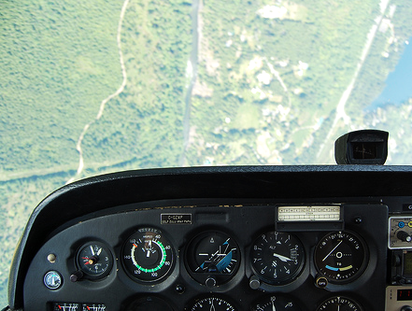
Instrument Flying Unusual Attitudes
Briefing copyrighted by Sunair Aviation Ltd.

Slide 2
Objectives
To recognise and recover to straight and level from a nose-high or nose-low unusual attitude

Slide 3
Considerations
Possible Causes
Interrupted scan caused by –
Distraction
High workload
Fixation
Disorientation
Prevention
Trust the instruments
Avoid fixation
Recovery
Recover to straight and level first
Then regain altitude and heading
-
-
-
-
-

Slide 4
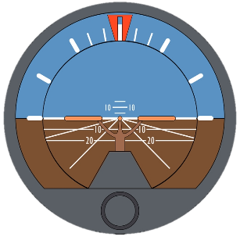
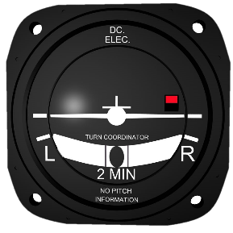
Considerations
Recovery
Check airspeed, stop further change
Adjust power to compensate
Roll wings level
Refer to altimeter
Increasing altitude – Lower nose
Decreasing altitude – Raise nose
Once the attitude has stabilised –
Limited Panel Recovery
Use T/C to roll wings level
Refer to altimeter for pitch
Change Check Hold Adjust Trim
-
-

Slide 5
Aircraft Management
Systematic Scan
Maintain situational awareness
Airmanship
Adequate height for recovery
Va, Vno, Vne and RPM limits
Above Va – full control movement not permitted
Smooth positive throttle movement
-
-
-
-
-

Slide 6
Human Factors
Disorientation
Limitations of the human orientation systems
Instrument failure is rare
Trust the instruments
Situational Awareness
Be aware of the weather around you
Avoid the need for instrument flying
-
-
-
-
-
IM SAFE

Slide 7
Air Exercise
High Nose Attitude
Recognition
Low or decreasing airspeed
Increasing altitude
Increasing RoC
Low engine RPM
Recovery
Full power and level the wings
Lower nose until airspeed and altitude stabilise
Reset cruise power
-
-
-
-
-
-
-
Change Check Hold Adjust Trim

Slide 8
Air Exercise
Low Nose Attitude
Recognition
High or increasing airspeed
Decreasing altitude
Increasing RoD
High engine RPM
Recovery
Reduce power and level the wings
Ease out of dive, caution high airspeed
Once airspeed and altitude stabilise, reset cruise power
-
-
-
-
-
-
-
Change Check Hold Adjust Trim

Slide 9
Air Exercise
Spiral Dive
Recognition
High or increasing airspeed
Decreasing altitude
High AoB, RoD and G-loads
High engine RPM
Recovery
Close throttle and level the wings
Ease out of dive, caution high airspeed
Once airspeed and altitude stabilise, reset cruise power
-
-
-
-
-
-
-
Change Check Hold Adjust Trim
Last Slide

