Slide 1
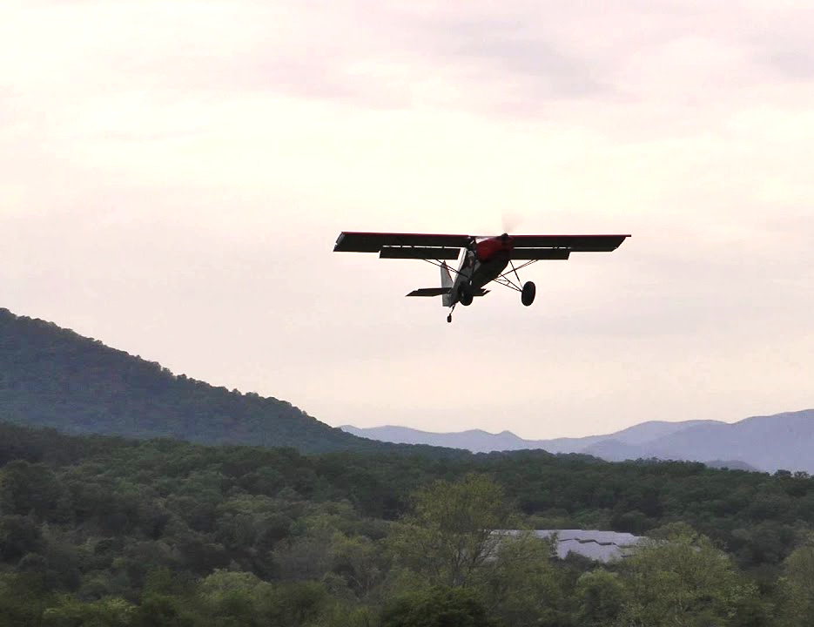
Slow Flight
Briefing copyrighted by Sunair Aviation Ltd.

Slide 2
Objectives
To slow the aeroplane and maintain straight and level at low airspeed (1.2Vs)
To maintain straight and level at low airspeed in various configurations
To maintain altitude while turning at low airspeed
To return to normal operating airspeeds

Slide 3
Principles of Flight
Power + Attitude = Performance
Lift = AoA x Airspeed
2° 110kts (High Power Setting)
4° 100kts (Normal Cruise)
8° 70kts (Low Power Setting)
At the desired attitude, power adjustments are necessary to maintain altitude
Attitude controls Speed, Power controls Altitude
L
T
D
W
Equilibrium: Constant altitude and airspeed

Slide 4
Principles of Flight
Drag Curve
As the aircraft’s speed reduces (when below min drag speed), drag increases
Power must then be added to overcome drag
Stall
DRAG
Total
Drag
Minimum Drag
4° A of A
AIRSPEED
Speed Unstable
Speed Stable
Best Range

Slide 5
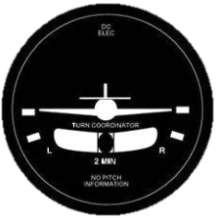
Principles of Flight
Control Effectiveness
At low airspeeds the controls are less effective
Larger inputs will be required
Adverse yaw will be more pronounced
Slipstream will be reduced
-
-
-
-
}
Balance with rudder
Notes:
Slipstream – Tail plane is set to be in balance at 2300rpm at a set airspeed thus a yawing tendency will be produced
Adverse yaw – Due to the larger control deflection, the increase in drag is more pronounced thus increasing adverse yaw, this combined with the less effective rudder will require larger inputs

Slide 6
Principles of Flight
Turning
Lift must be increased in a turn, this is achieved by increasing the angle of attack
Drag will increase, thus more power is required when entering a turn
Stall speed increases due to increased lift requirement
-
-
-
TR
L
TR
D
Notes:
Slipstream – Tail plane is set to be in balance at 2300rpm at a set airspeed thus a yawing tendency will be produced
Adverse yaw – Due to the larger control deflection, the increase in drag is more pronounced thus increasing adverse yaw, this combined with the less effective rudder will require larger inputs

Slide 7
Aircraft Management
Throttle
Smooth positive use
Carb Heat
Hot below rpm green range
T’s & P’s
Less airflow for engine cooling
Increase airspeed if required
HASELL Check
-
-
-
-
HASELL Check

Slide 8
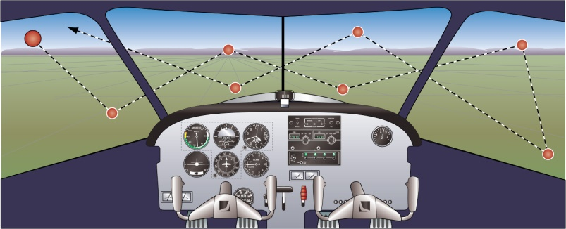
Human Factors
Lookout
Sectored scan
Situational Awareness
Aircraft configuration
Stalling symptoms
Training area boundaries
Stress
High level of concentration
Unfamiliar with high nose attitude
Reduced through exposure
-
-
-
-
-
-
-
IM SAFE

Slide 9
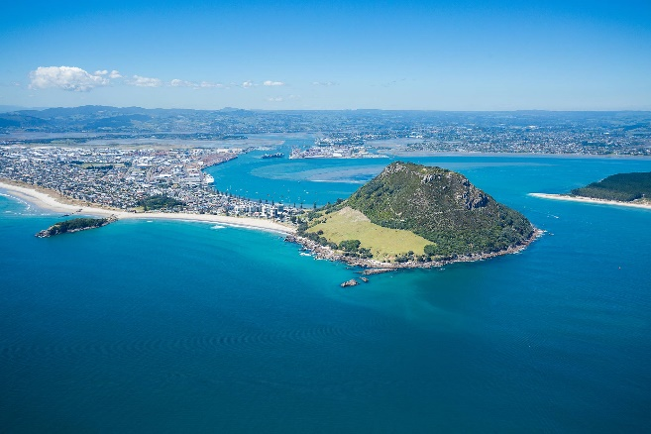
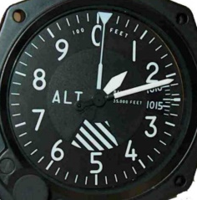
Air Exercise
Straight and Level at Low Airspeed
Entry
HASELL Check
Select reference point, reference altitude
Power
Attitude
Trim
Through approximately 60kts increase power
Adjust power to maintain 55kts
-
-
- Carb heat Hot
- Reduce power to 1500rpm
- Increase backpressure to maintain altitude
- Balance with rudder
- To relieve backpressure
-
-

Slide 10
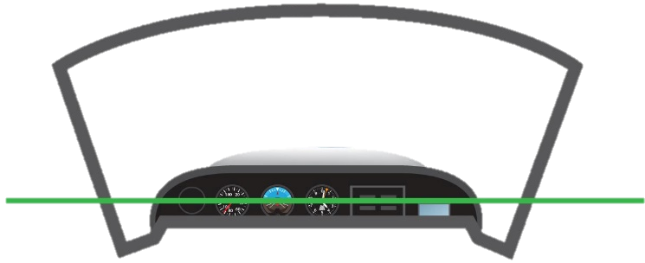
Air Exercise
Straight and Level at Low Airspeed
Maintain
Lookout – Traffic, cloud, terrain, reference point
Attitude – Confirm correct (adjust to maintain speed)
Instruments – Altitude, speed, balance ball

Slide 11
Air Exercise
Turning at Low Airspeed
Increased drag will require an increase in power
More rudder required to compensate for adverse yaw
Lower nose attitude during the turn to maintain safe margin above stall
speed (+ 5kts)
Limit AoB to 20°
-
-
-
-

Slide 12
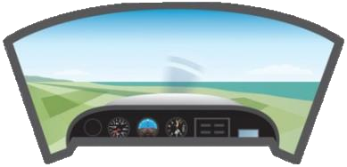
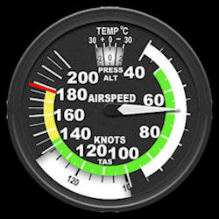
Air Exercise
Returning to Cruise
Power
Attitude
Trim
Through 90kts reduce power to 2200rpm
- Increase to full power
- Balance with rudder
- Smoothly lower the nose to cruise attitude
- To relieve control column pressure
-

Slide 13
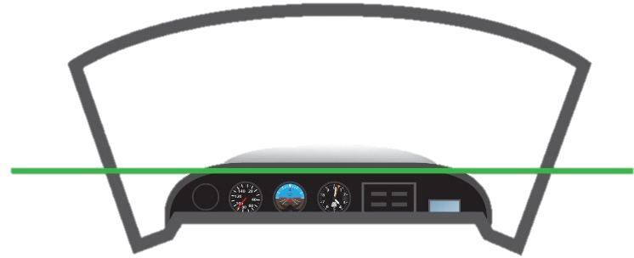
Air Exercise
Flaps Down Configuration
Entry
Flaps to 20⁰ - through 85kts
Airspeed - 50kts
Maintain
Slightly lower nose attitude
Exit
Smoothly increase to full power
Raise nose to the horizon
Raise flaps in stages above 60kts
-
-
-
-
-
-
Last Slide

Slide 14
HASELL Check
HASELL Check
Height - Sufficient to recover by a safe height
Airframe - Entry configuration revised: Idle power, flap up
Security - Hatches and harnesses secure, no loose items
Engine - T’s & P’s Green Range, Mixture full rich, Fuel
Location - Unpopulated
Lookout - 1 x 180° or 2 x 90° turns
Return

