Slide 1
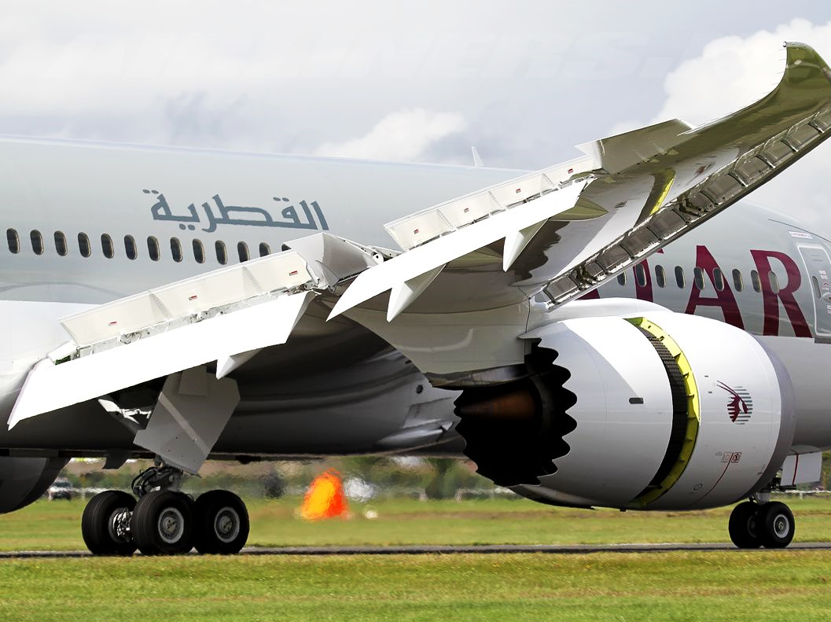
Effects of Ancillary Controls
Briefing copyrighted by Sunair Aviation Ltd.

Slide 2
Objectives
To operate the primary control surfaces and observe the secondary aerodynamic effects on the aeroplane in flight
To operate the ancillary controls and to experience the feel and observe the effect on the aeroplane in flight

Slide 3
Principles of Flight
Elevator
Has no secondary aerodynamic effect
Changes in pitch causes:
Change in airspeed
Gain and loss of altitude

Slide 4
Principles of Flight
Further (secondary) effect of aileron
Roll (primary)
Slip
Yaw (secondary)
Notes:
Use model to demonstrate also – back up the limited animation

Slide 5
Principles of Flight
Further (secondary) effect of rudder
Yaw (primary)
Skid
Left wing shielded
Right wing moves faster
Roll (secondary)
Notes:
Use model to demonstrate – assist the limited animation

Slide 6
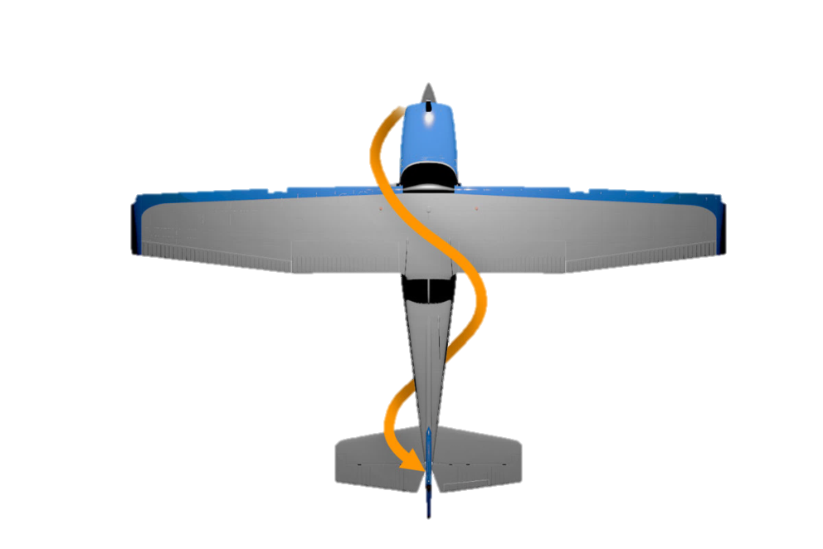
Principles of Flight
Slipstream
Column of air accelerated rearwards by the propeller
Opening the throttle increases propeller rpm and slipstream
An increase in power (and slipstream) will increase the
effectiveness of the elevator and rudder
-
-
-
The rotational nature of the slipstream causes it to impact the vertical tail plane producing a yawing tendency
Depends on the direction of propeller rotation

Slide 7
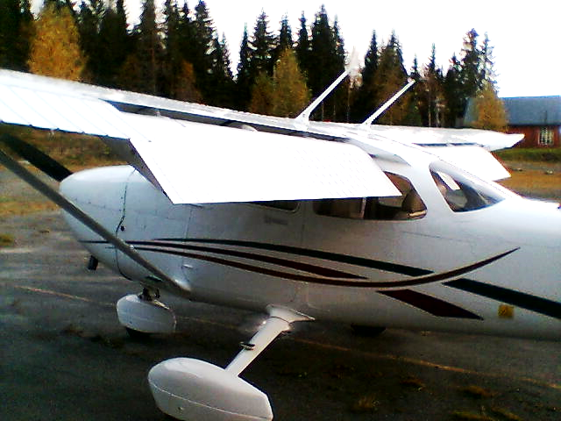
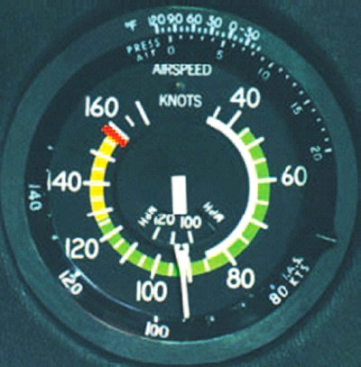
Principles of Flight
Flaps
Alter the wing shape and increase angle of attack
Lift and Drag increase
-
-
L
0°
Flaps Up
10°
20°
D
30°
RAF
L
Flaps Down
D
0°
10°
20°
White Arc – Flap operating range
30°
RAF

Slide 8
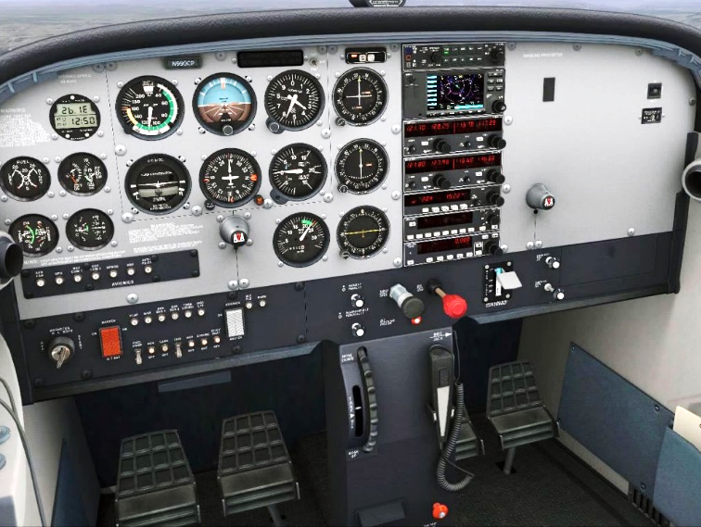
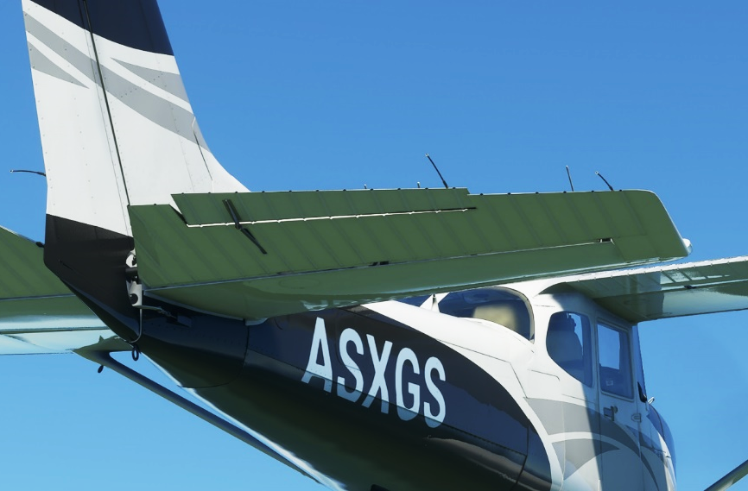
Principles of Flight
Trim
A device attached to the primary controls to relieve flight control pressures
Trim Wheel
Elevator Trim Tab
Change Check Hold Adjust Trim

Slide 9
Principles of Flight
Carburettor Icing
Throttle Icing
Throttle Icing
As the fuel-air mixture accelerates past the throttle butterfly there is a
drop in temperature
Especially at low power settings throttle icing may occur causing a
complete blockage of the carburettor
Refrigeration Icing
When fuel vaporises its temperature drops substantially
Forms downwind of the fuel nozzle in the carburettor’s throat
This ice restricts the airflow and thus reduces the engine power output
Occurs with low temperatures and high humidity
Can occur as high as 25°
-
-
Refrigeration Icing
-
-
-
-
-

Slide 10
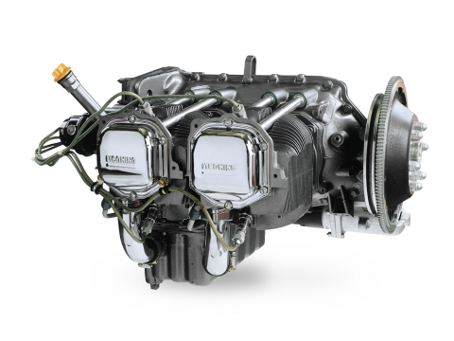
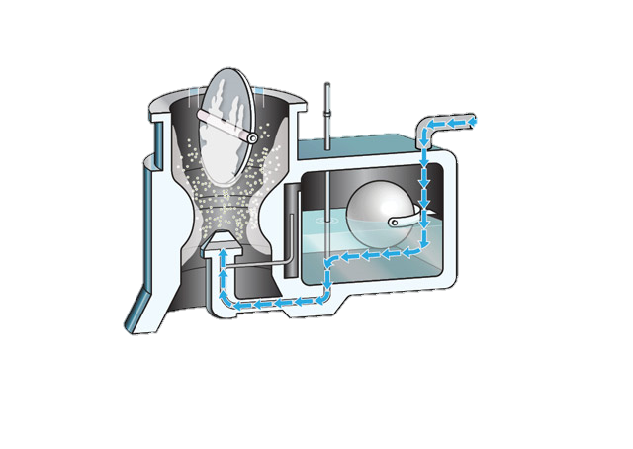
Principles of Flight
Carb Heat Off
Air
To Engine
Exhaust
Carb Heat
Carburetor
OFF ON
Air

Slide 11
Principles of Flight
Carb Heat On
Air
To Engine
Exhaust
Warm air – Less Dense
Carb Heat
Cold air – More Dense
Carburetor
OFF ON
Air

Slide 12
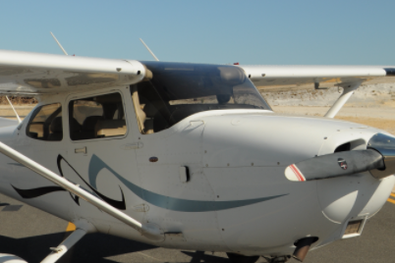
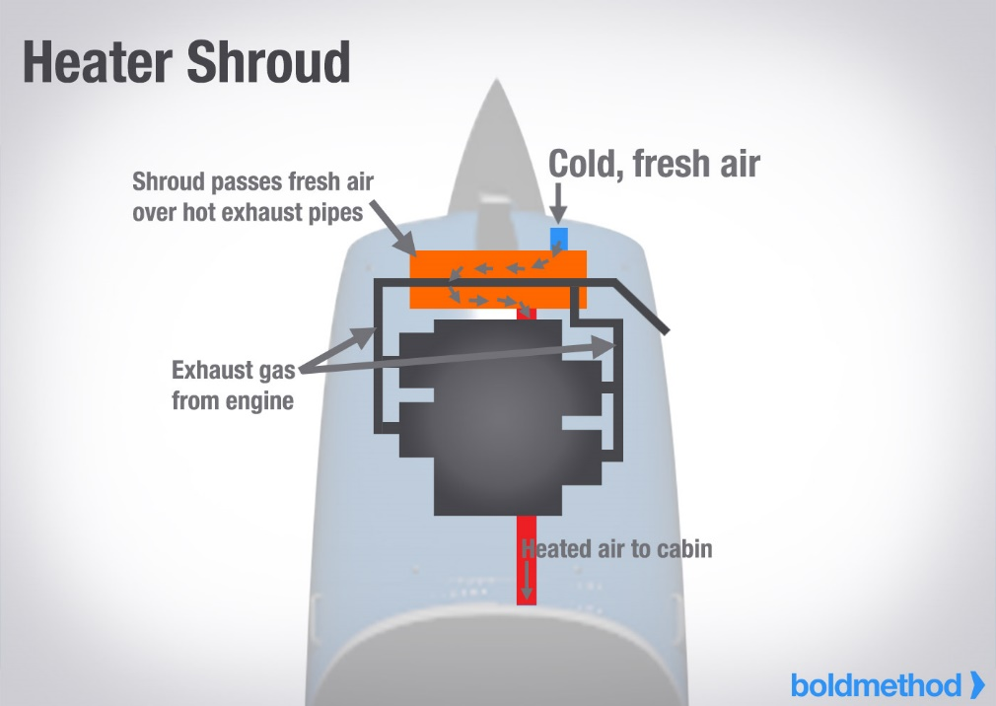
Principles of Flight
Environmetals
Cabin Air / Heat controls
Cabin Heat
Cabin Air
Cabin Air
Cabin Heat
Additional air vent

Slide 13
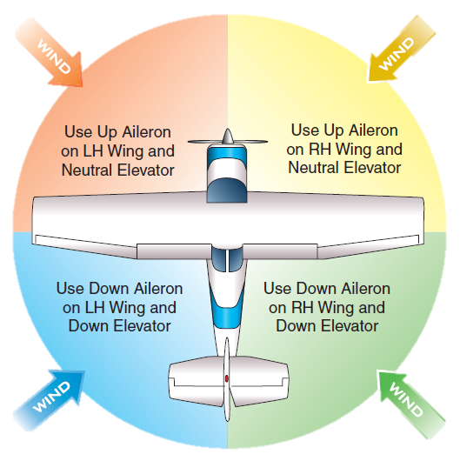
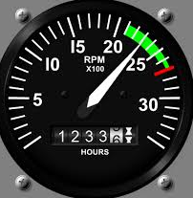
Aircraft Management
Throttle
Controls propeller rpm
Requires smooth operation
Mixture
Controls fuel : air ratio
Full rich for training
Leaning procedure
Carb Heat
Hot below Green Arc
T’s and P’s
Green range
Flap Limits
White Arc (below 85kts)
Pre Flight Inspection
Clean Windscreen
-
-
-
Taxiing
Control Position in wind
-
-
-
-
-
-
-

Slide 14
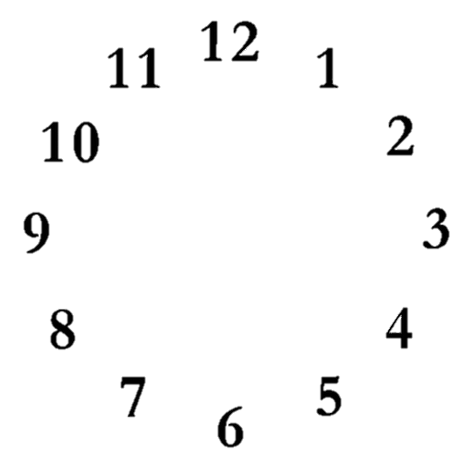
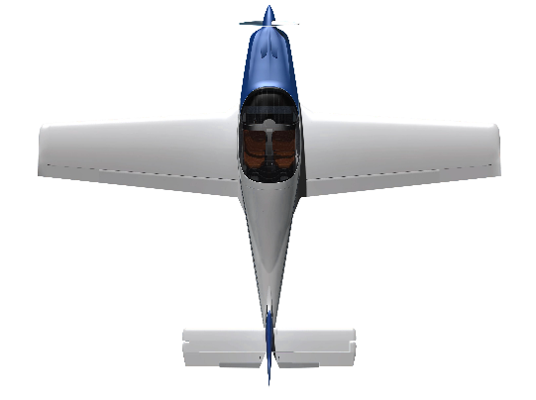
Human Factors
Lookout
Traffic
Terrain
Cloud
Clock Code
High
Level
Low
Situational Awareness
See-and-be-seen
Surroundings
Weather
-
-
-
-
-
-
-
-
-
IM SAFE

Slide 15
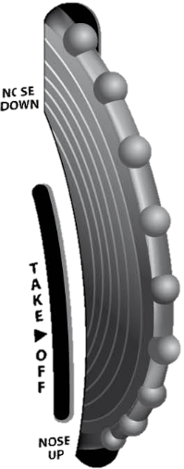
Air Exercise
Observe Training Area Boundaries
Further Effects of Primary Controls
Slipstream
Elevator and rudder more effective
Ailerons unaffected by slipstream
Power
Increase power: Nose pitches up and yaws left
Decrease power: Nose pitches down and yaws right
Flaps
Lowering flaps: Nose pitches up initially
Raising flaps: Nose pitches down initially
Note: Pitch change is relative to aircraft type
Elevator Trim
Holding forward – Trim forward
Holding back – Trim back
Environmentals
Cabin Heat
Cabin Air
-
-
-
-
-
-
-
-
-
-
-
Last Slide

