Slide 1
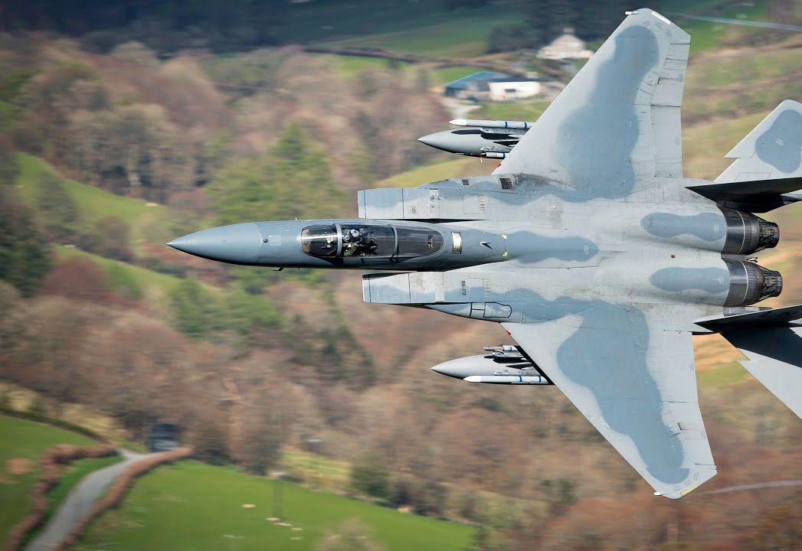
Constant Radius Turns
Briefing copyrighted by Sunair Aviation Ltd.

Slide 2
Objectives
To maintain a constant distance from a surface feature, while turning, allowing for the wind

Slide 3
Considerations
Reasons for Constant Radius Turn
Search and Rescue (circling)
Surveillance
Handling / Coordination practice
Wind
Tailwind » Higher G/S » More AoB
Headwind » Lower G/S » Less AoB
Speed in the Turn
Higher speed, greater AoB
Poor Visibility Configuration
Distance from Feature
Less turn radius, greater AoB
-
-
-
-
-
Poor Visibility – 70kts
Normal Cruise – 100kts
-
-
Less AoB
-

Slide 4
Aircraft Management
Poor Visibility Configuration
70kts, 10 - 20⁰ flap
Cycle carb heat regularly
HASELL+L
Prior to entering LFZ
Airmanship
LFZ boundaries
Minimum heights
-
-
-
-
-

Slide 5
Human Factors
Vision
Be aware of the visual illusions caused by drift
Scan instruments regularly, especially balance ball
-
-
IM SAFE

Slide 6
Air Exercise
Speed in the Turn
Demonstration
First constant radius turn flown at cruise speed – Large turn radius
Second turn flown using poor visibility configuration – Small turn radius
-
-

Slide 7
Air Exercise
Constant Radius Turn
Prior to Entry
Identify 4 points equidistant from feature
Assess the wind
Tailwind – Higher G/S, more AoB
Headwind – lower G/S, less AoB
Maintain distance from feature throughout turn
Entry
Roll in with aileron
Balance with rudder
Check ≈ 45⁰AoB
Power as required to maintain speed
Maintain
Lookout – Terrain, reference feature
Attitude – Confirm correct
Instruments – Height, bank, ball
Vary AoB to maintain distance from feature
Wind
-
-
-
-
-
High G/S
High AoB
-
-
-
-
Low G/S
Low AoB
-
-
-
-
Last Slide

