Slide 1
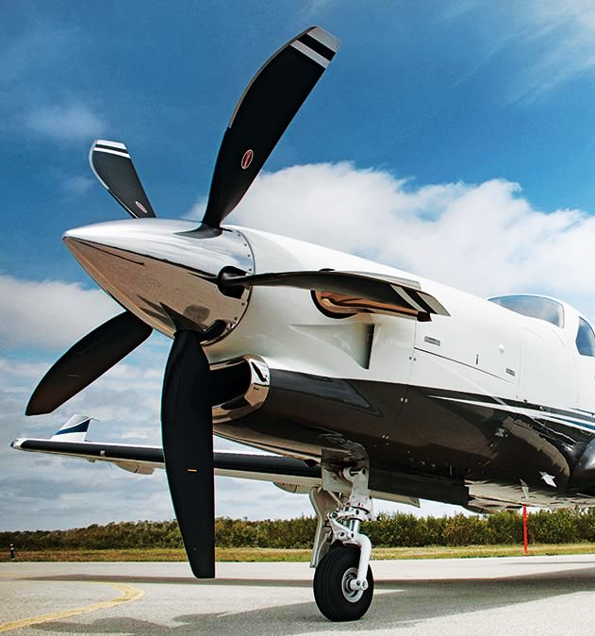

Principles of Flight
- PROPELLERS
The following content is in A4 size enabling the content to be printed easily.
Content copyrighted by Sunair Aviation Ltd.

Slide 2
THRUST
Thrust is the force that opposes drag in level flight.
Prop Torque
TR
Angle of Attack
- Angle between RAF and chord line
Helix Angle
- Angle between plane of rotation and RAF
Blade Angle
- Angle between plane of rotation and Chord line
Actual Pitch
- Distance travelled by prop in one rotation
Geometric Pitch
- Distance travelled by prop in one rotation at 0° AOA
Experimental Mean Pitch
- Distance travelled by prop in one rotation at zero thrust
Slip
- Distance between Actual pitch and EMP, most
efficient at 30% slip
100% Slip
- Full power, brakes on = No forward movement
= No work done
0% Slip
- Glide, large distance travelled, no thrust = No work done
T
Plane of rotation
Helix
Angle
AOA
Blade Angle
Line of zero thrust
Chord line
RAF
+4° 0° -4°
Direction
of travel
Actual pitch
Slip
Geometric pitch
Experimental mean pitch (EMP)

Slide 3
PRODUCTION OF LIFT ON A BLADE
TR
Plane of
rotation
70%
Blade length %
100%
TR
Direction
of travel
Greatest lift produced at 70% (approx) from hub.
The TR of the outer blade section is more tilted inline with the direction of travel.

Slide 4
PROPELLER TWIST
Propeller twist is a reduction in blade angle from root to tip.
Propeller twist ensures a constant AOA is maintained over the blade.
RAF
RAF
Forward velocity in ½ a revolution

Slide 5
VARIABLE PITCH PROPELLER
Constant speed units are used to allow pitch to change as speed changes.
The CSU ensures that constant AOA is maintained over a range of speeds.
Constant
RPM
Fast
Slow
RAF
RAF
Fine Coarse
TAS
Peak efficiency
Efficiency
Fine pitch limit
Coarse pitch limit
TAS

Slide 6
POWER ABSORPTION
Solidity is a measure of the propellers ability to absorb engine power.
Ways of increasing Solidity
Chord = blade area
Aspect Ratio
No. of Blades = blade area
Cost of manufacture, blade interference
Other ways of increasing power absorption
Camber = TR and prop torque
Efficiency
RPM = Drag and prop torque
Tip speed
Blade length = Larger disc area, prop torque
Tip speed
Blade angle = AOA and prop torque
Efficiency
Blade Area
Area of Air
Solidity =

Slide 7
CENTRIFUGAL TWISTING MOMENT
Pitch change
axis
CFF CFF
Pitch change
axis
CTM acts to Fine the blade.
CTM CTM
CFF acting on the blade originates from the centre of rotation.
Increasing blade width or RPM results in an increase in CTM.

Slide 8
AERODYNAMIC TWISTING MOMENT
ATM occurs when the TR does not act through the pitch change axis
Normal flight
Windmilling
TR
Pitch change axis
Pitch change axis
TR
Plane of rotation
RAF
Plane of rotation
RAF
Direction of travel
Direction of travel
Under normal flight conditions ATM acts to Coarsen the blade.
Under windmilling flight conditions ATM and CTM both act to Fine the blade.

Slide 9
FORCES ON A PROPELLER BLADE
Cruise
Windmilling
Reverse thrust
(power-on brake)
Prop torque
Prop torque
TR
TR
D
L
T
Windmilling drag
T
TR
Prop torque
Rotational velocity
Rotational velocity
Rotational velocity
TAS
TAS
TAS
Propeller torque acts in the same direction as engine torque.
Reverse thrust acts opposite to the direction of travel.

