Slide 1
CIRCUIT INTRODUCTION
OBJECTIVES
To takeoff and follow published procedures that conform to the aerodrome traffic circuit, avoiding conflict with other aircraft
To carry out an approach and landing using the most suitable runway
Considerations
Takeoff
Power – Full power
Swing on takeoff – Slipstream
- Torque
- Both effects yaw aircraft left – Right rudder
Flaps - Increase lift and drag
- Refer flight manual
Wind - Headwind – Shorter ground roll / better obstacle clearance
- Crosswind - Aircraft tends to “weathercock”
Approach & Landing
Power – Controls rate od descent
Attitude – Controls airspeed
Flaps - Decrease ground roll, increase visibility, steeper approach angle
Wind - Headwind - Shorter ground roll / better obstacle clearance
Runway Slope
- Takeoff - Downslope → Shorter ground roll
- Landing - Upslope → Shorter ground roll
AIR EXERCISE
1. Lineup checks
2. After takeoff checks (above obstacles)
3. Check tracking
- Commence downwind turn at approximately 800 - 1000ft
4. Downwind / Pre-landing checks
5. Check and note spacing
- Downwind radio call
6. Carb heat Hot
- Reduce power to 1500rpm
- Keep straight, maintain altitude
- White arc, lower 10° flap
- Set attitude for 75kts, hold and trim
7. Check tracking
- Lower 20 °flap
- Set attitude for 70kts
8. Anticipate centreline
- Commence turn so as to roll out on
centreline at 500ft AGL
9. Full flap (as appropriate)
- Carb heat cold
- Use power to control rate of descent
and approach
- Set attitude for 65kts
Touch & Go
- Gently lower nose after touchdown
- Flaps up (takeoff setting)
- Smoothly apply full power / normal takeoff
Min 500ft AGL
3
Lookout
Crosswind
Lookout
Greater friction
4
1000ft
Up wind
2
5
Downwind
6
1
9
45˚ nil wind
Final
Base
Lookout
7
8
Lookout
Aircraft Management
Right of Way Rules
– A/C landing have ROW over A/C
taking off
- A/C in the circuit have ROW over
A/C joining
- Follow at a safe distance, do not
overtake another A/C
- Circuit height 1000’ AGL (Ref AIP)
SCADIE Check - Monitor gauges during circuits
Human Factors
Vision - Runway perspective (Width /
Slope)
Information Processing
- Increased workload
- Regular practice
- Mnemonics
Situational Awareness
- Lookout & listen out
- Wind direction
IMSAFE

Slide 2
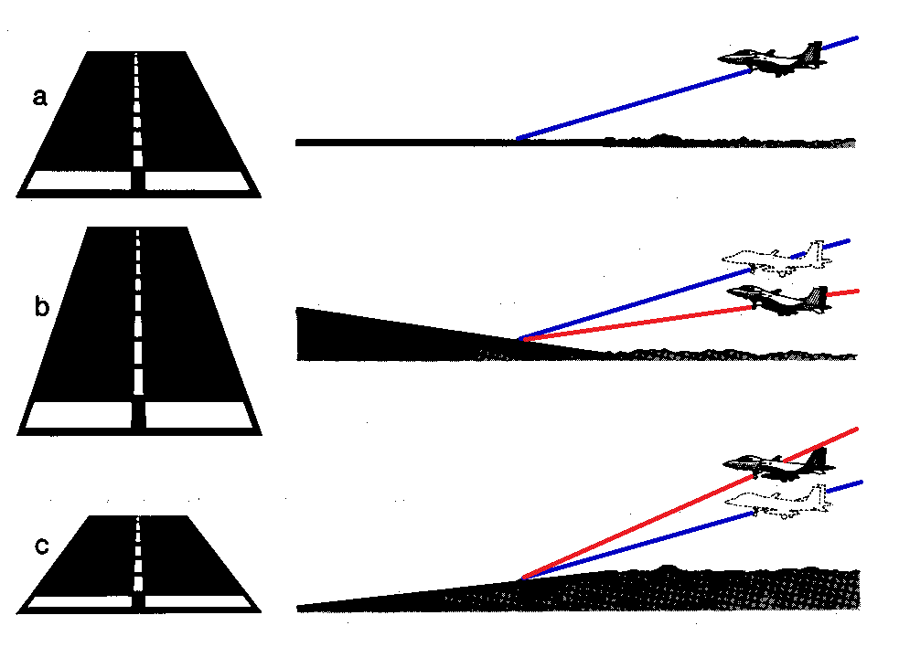
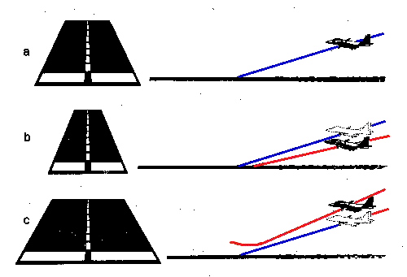
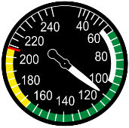
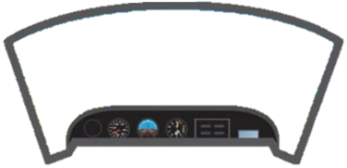
Slipstream & Torque
Runway Slope
Nil slope on profile
Upsloping runway
Downsloping runway
Runway Width
Normal Width
Narrow Runway
Wide Runway
More Friction
Power & Nose attitude on approach
Effect of flaps

