Slide 1
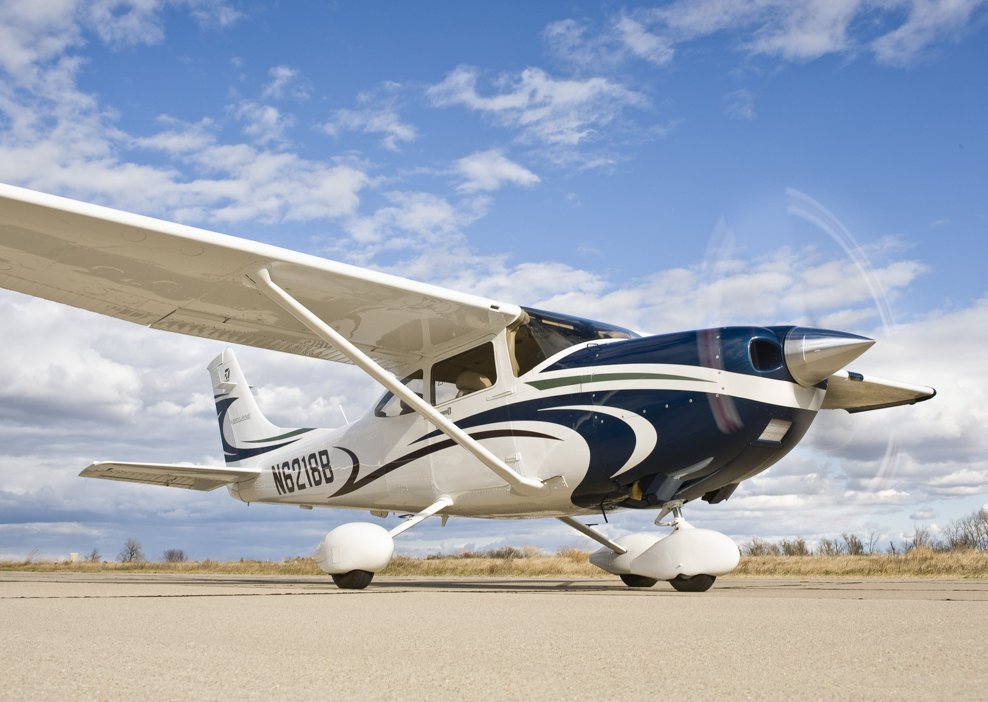
Principles of Flight
- AERODYNAMICS
The following content is in A4 size enabling the content to be printed easily.
Content copyrighted by Sunair Aviation Ltd.

Slide 2
SWING ON TAKEOFF
TRICYCLE / TAILWHEEL
Slipstream
- Airflow strikes fin on left side.
- Aircraft yaws left.
Torque
- More drag on left wheel.
- Aircraft yaws left.
Wind
- Greater surface area
behind the pivot point.
- Aircraft yaws into wind.
TAILWHEEL ONLY
Asymmetric blade effect
Thrust vector moves right
RAF
TAS
RAF
Down-going blade travels greater distance, therefore meeting the RAF at a higher AOA.
Greater friction
Gyroscopic effect
Force is precessed 90° in the direction of travel.
Arm
Thrust vector moves right
Wind

Slide 3
FORCES IN A CLIMB
T > D
T = D + RCW
L < W
Rate of climb =
Height
Time
R2
L
RAF
Depends on excess power
D
T
RCW
PA
Power
W1
w
t
W
P =
R1
Stall
PR (drag)
Climb angle
Angle of climb =
Height
Distance
Depends on excess thrust
Vy (best rate) TAS
Thrust
TA
Factors affecting AOC Factors affecting ROC
Weight TR AOC Weight PR ROC
Drag TR AOC Drag PR ROC
Altitude TA AOC Altitude PR PA ROC
Headwind Gs AOC Wind – No effect
Tailwind Gs AOC
Stall
TR (drag)
Vx (best angle) TAS

Slide 4
FORCES IN STRAIGHT AND LEVEL
The four forces acting on an aircraft in level flight are – Lift, Weight, Thrust, Drag.
L
Equilibrium
L = W T = D
T
D
W
The L/W and T/D couples oppose one another. The L/W couple is greater than the T/D couple.
The L/W and T/D couples act in the same direction.
L
C of P
L
D
T
T/D L/W
couple couple
T
T/D L/W
couple couple
C of G
D
C of G
Stabilizing force
C of P
Permanent down force
W
W

Slide 5
FORCES IN A TURN
L
Apparent weight (lift)
Actual weight
VCL
Load Factor =
LF =
HCL
Turning force acting towards the centre of the turn.
1
COS θ
h
CPF = HCL CFF
CFF
a
Apparent force acting away from the turn.
TR
o
W
TR
W CFF
Rate 1 turn
360° in 2 minutes
1 1
COS 30° 0.866
LF at 30° AOB = = = 1.15g
LF at 60° AOB = = = 2g
1 1
COS 60° 0.5
Airspeed
10
100kts
10
AOB = + 7
= 10 + 7 = 17° AOB
Stall in a turn
VST = VS × √LF
30° AOB = 52 × √1.15
= 56kts
60° AOB = 52 × √2
= 73kts
Angle of bank
Depends on speed - which determines the radius.
TR
W CFF

Slide 6
FACTORS AFFECTING THE TURN
Angle of bank
Airspeed
Same IAS
Same bank angle
VCL
L
120kts
80kts
HCL
Small turning force,
large radius,
low rate of turn
Larger turning force,
smaller radius,
higher rate of turn
Larger radius and lower rate of turn.
Smaller radius and higher rate of turn.
Altitude
Weight
Same IAS and bank angle
Higher TAS
TAS
- Higher weight
means a higher
AOA and stalling
speed.
W
W
Larger radius and lower rate of turn.
Smaller radius and higher rate of turn.
Weight affects only the maximum rate and minimum radius that can be achieved by an aircraft in a turn.

Slide 7
MAX RATE TURN
VCL
L
VCL
L
Radius
Low IAS
- 15° AOA
- Max. bank
angle
HCL
Higher IAS
- 15° AOA
- Max. bank
angle
HCL
W
W
‘G’ limit
- Small CPF
- Large radius
- Low rate of turn
- Greater CPF
- Smaller radius
- Higher rate of turn
Stall VB VA
IAS
Requirements
- Max turning force
- Max lift
- Max angle of bank
- Max power
Limitations
- Pilot ‘g’ loading
- Aircraft ‘G’ loading
- Power available
- Critical AOA

Slide 8
FORCES IN A GLIDE
Weight
R
Higher rate of descent.
Constant descent angle.
R
D
L
FCW
D
FCW
W
W1
RAF
Drag
W
R
R
FCW
L
L
Descent angle
D
D
FCW
FCW
Factors affecting the glide
Weight - No effect
Drag - Steepens glide angle
Headwind - G/S steeper glide angle
Tailwind - G/S shallower glide angle
W
W
Wind
Tailwind
Headwind

Slide 9
CONTROLS
Changes in camber are used to control the aircraft.
Aerodynamic balance
- Moves C of P closer to the hinge line.
- Less stick force required.
Horn balance
Inset hinges
Hinge line
Hinge line
Trim tab
- Creates a small force over a long arm to maintain
control position, relieving stick force.
Control surfaces are located at large distances from the C of G giving good controllability with small forces.
Arm
Mass balance
-Used to prevent flutter of control surfaces.
-Moves C of G closer to hinge line.
Balance tab
- Moves automatically as the elevator is moved.
- Less stick force required.
Mass/ weight
Mass/ weight
C of G
Anti-balance tab
- Avoids overbalance.
- Keeps C of P rearward of hinge line
C of G
Hinge line
C of G
C of P
Mass/ weight

Slide 10
FLUTTER
Flutter is the vibration / oscillation of control surfaces.
Aileron hinge
C of G
Aileron reversal
- Occurs due to the wing twisting
about its torsional axis.
- Gust makes wing
flex upward.
Torsional axis
- Aileron lags behind
increasing wing flex.
Avoided by constructing the wing with sufficient stiffness about its torsional axis.
RAF
- Wing reaches elastic limit
and begins to spring back
down.
- Aileron lags behind, increasing downward
flex which continues to lower elastic limit
and the cycle repeats itself.

Slide 11
STABILITY
Stability is the tendency of an aircraft to return to straight and level following a disturbance.
An aircraft must have static stability before it can be dynamically stable.
Negative
Neutral
Positive
Positive
An aircraft can be statically stable but dynamically unstable at the same time.
Neutral
Negative
Initial
reaction
Subsequent reaction
STATIC
DYNAMIC
Longitudinal stability
- C of G position
- Tailplane design
- Longitudinal dihedral
- Wing pitching moment
Lateral stability
- Dihedral / Anhedral
- Wing position
- Keel surface
- Sweepback
- Shielding
L
L
RAF
RAF
L
L
Directional stability
- Fin area
- Moment arm
W
W
Spiral instability
More directional stability than lateral.
Dutch roll
More lateral stability than directional.
4° AOA 2° AOA

Slide 12
IAS vs TAS
IAS - The airspeed measured by the ASI – ½ ρ V²
TAS - The actual distance travelled through the air – V =
d
t
SL
100kts 100kts
IAS TAS
10,000ft
100kts 120kts
IAS TAS
At Sea Level - Air density is high, and therefore IAS and TAS are the same.
At 10,000ft - Air density decreases, and therefore a higher TAS is needed to maintain pitot pressure (IAS)

