Slide 1
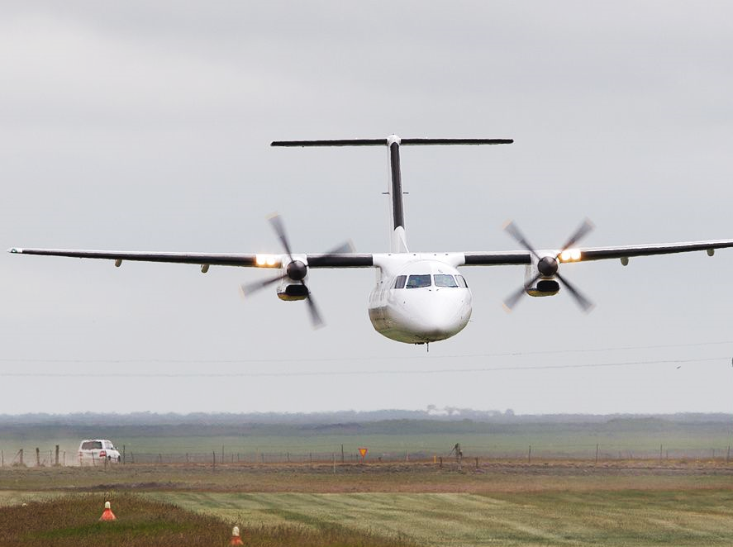
Straight and Level
Briefing copyrighted by Sunair Aviation Ltd.

Slide 2
Objectives
To establish and maintain straight and level flight, at a constant airspeed, altitude, direction and in balance
To regain straight and level flight
To maintain straight and level flight at selected airspeeds or power settings

Slide 3
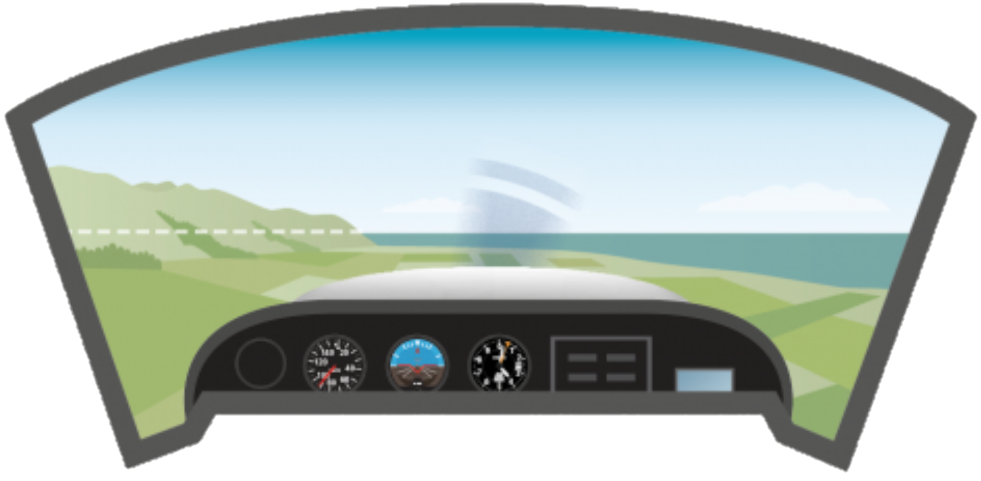
Principles of Flight
Horizon
In VFR flight, straight and level is accomplished with reference to the horizon
Weather or terrain can hide the actual horizon
Artificial horizon may be used where no actual horizon exists
-
-
-

Slide 4
Principles of Flight
Forces in Straight & Level
Weight
Lift
Thrust
Drag
Equilibrium: Constant direction and airspeed
L
L = W T = D
T/D Couple
D
T
Tail plane and elevator provide
pitch balancing moment
L/W Couple
W

Slide 5
Principles of Flight
Lift Formula
L =
C_{L}
_{½ ρ V}²
S
Camber
Indicated Airspeed
Wing Surface Area
Angle of Attack
L = Angle of Attack x Airspeed
Power + Attitude = Performance

Slide 6
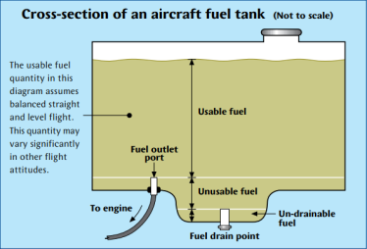
Aircraft Management
Throttle
Recommended cruise 2200rpm
Smooth, positive throttle movements
Mixture
Full rich for training
Lean at altitude
Idle-cut-off
Carb Heat
Hot below rpm green range
Fuel Management
(fuel drains, unusable/usable fuel)
SCADIE Check
-
-
-
-
-
-

Slide 7
Aircraft Management
Suction - Green range (4.5 – 5.4 in.Hg.)
Carbon monoxide
Ammeter - Zero or positive charge
D.I. - Direction Indicator aligned with magnetic compass
Icing - Cycle carb heat
Engine - Oil temperature and Pressure (T’s & P’s)

Slide 8
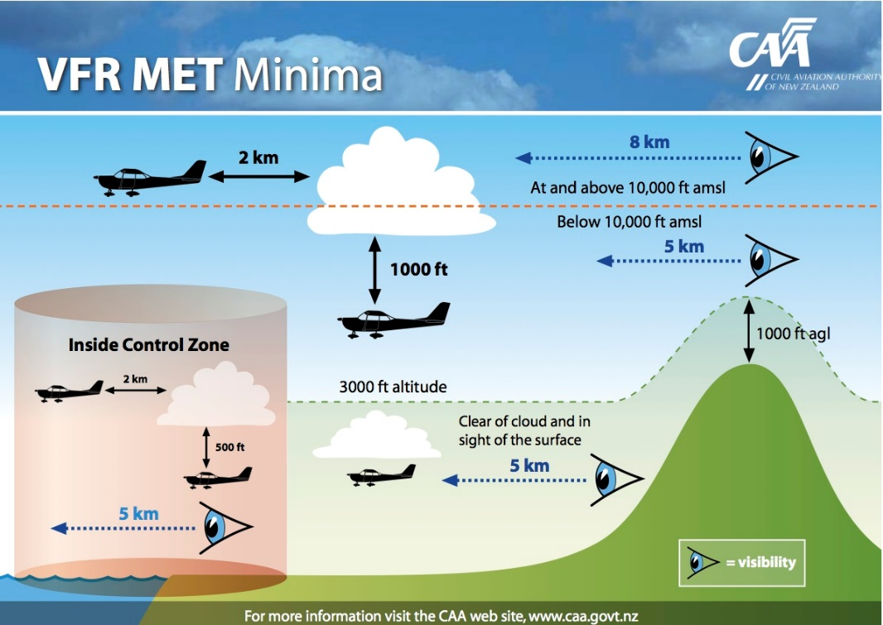
Aircraft Management
VFR Met Minima
Uncontrolled aerodromes
600ft cloud ceiling
1500m visibility
Uncontrolled airspace 3000ft AMSL
Clear of cloud
In sight of the surface
5km visibility
Orientation
Local landmarks
-
-
-
-
-
-

Slide 9
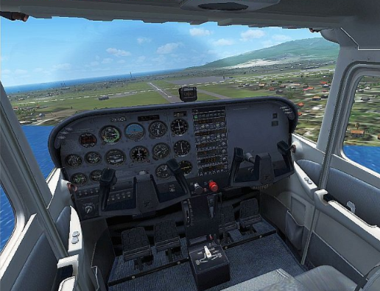
Human Factors
Lookout
Blindspots
Sectored scan (2 sec per 20 degrees)
Situational Awareness
Other traffic, weather, terrain
Airmanship
I have You have control
Training area boundaries
-
-
Blind spots
-
-
-
IM SAFE

Slide 10
Air Exercise
Reference
Select reference point
Select reference altitude
Configuration
2200rpm
Note nose attitude relative to the horizon
Wings level
Balance ball centralised
Aircraft trimmed for S&L attitude
Airspeed approximately 100kts
Establishing S&L
Power – Set cruise power
Attitude – Visually set and hold nose attitude
Trim – Relieve control column pressure
Maintain
Lookout – Traffic, Cloud, Terrain
Attitude – Check nose attitude and reference point
Instruments – Quick glance to confirm altitude, balance, and speed
-
-
-
-
-
-
-
-
Last Slide

Slide 11
Air Exercise
Power + Attitude = Performance
Demonstration
Straight and Level flight at different power settings and configurations
-
Last Slide

